Slide 1

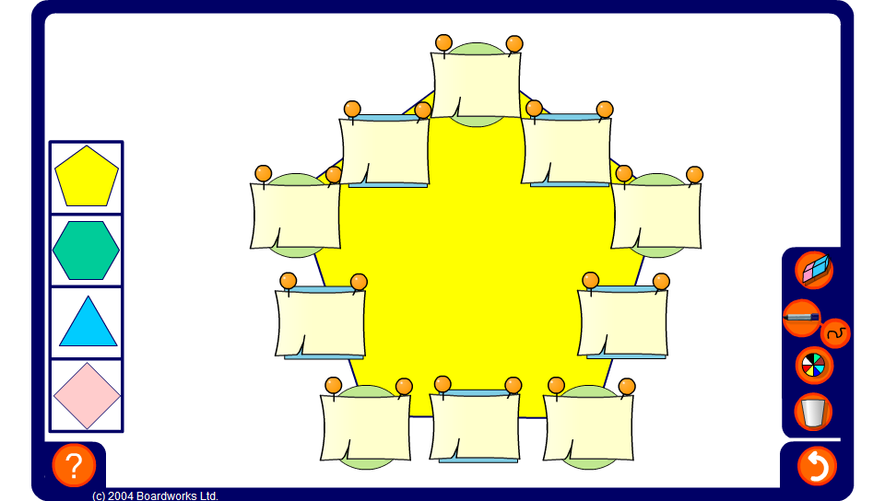


Arithmagons – integers
Notes:
Use the arithmagon on this slide to practise adding and subtracting positive and negative integers. Press reset for a new puzzle or change the shape of the puzzle by selecting one of the shapes on the left.

